Slide 1
Relational Algebra Query language

Slide 2
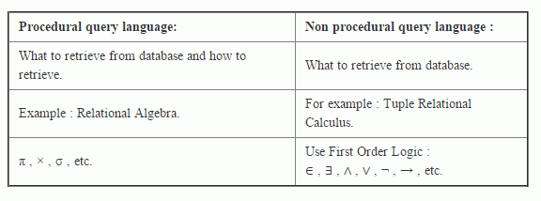
Two types of query language :

Slide 3
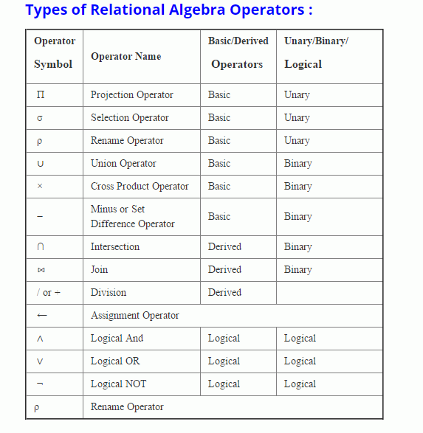
Relationalalgebra Relational algebra is a procedural language. It provides operators which performs operations on existing relation to derive results relations. It results always distinct tuple.

Slide 4
Characteristics of relational operators :
Relational operators always work on one or more relational table.
Relational operators always produce another relational table.
The result table produced by a relational operator has all the properties of relational model.
Union, intersection and difference operation, the two operand relations must be Union compatible.
Meaning of Union compatible property :
Number of attributes should be same between R and S
Range of attributes should be similar where Range = Type of values accepted by attributes.

Slide 5
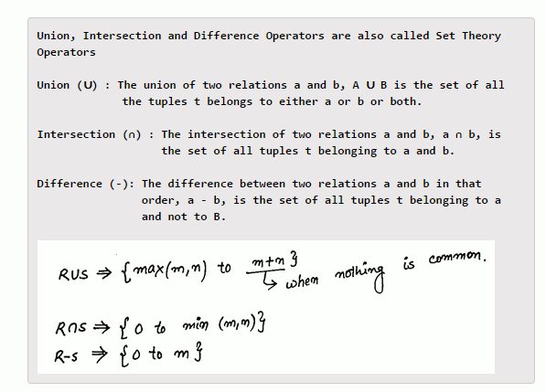

Slide 6
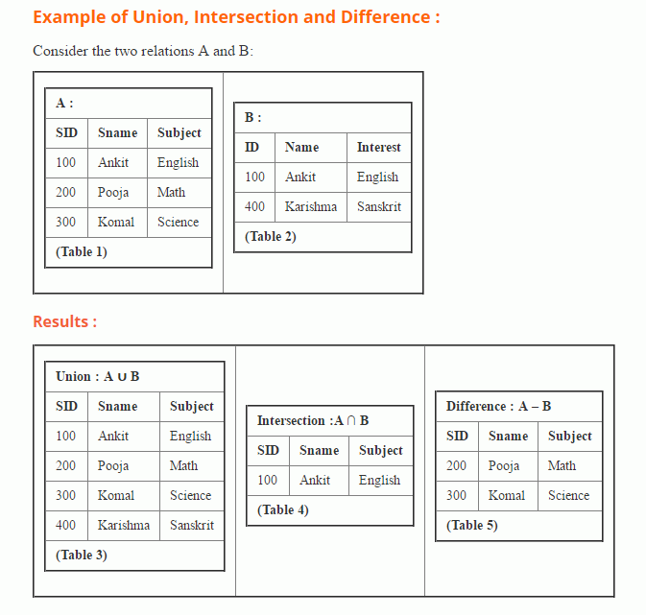

Slide 7
Product or Cross Product (×):
The product of two relations is a cartesian product and it is the concatenation of every tuple of one relation with every tuple of a second relation. If the relation A has m tuples and the relation B has n tuple then A × B have m times n tuples. If any one of R and S is empty, R × S ⇒ Φ

Slide 8
Need of Cross Product :
In order to compare data of 2 tables like Student.SID>Enrollment.RollID
To compare data within a table. (Student × Student).

Slide 9
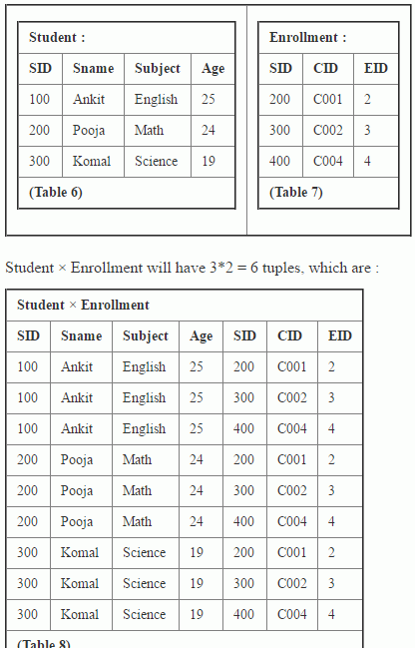

Slide 10
Projection :
Projection is an operation that select specified attributes from a relation. It is used to filter the column . The result of the projection is a new relation having the selected attributes. It can also be used to change the order of attributes in a relation.
Syntax :
π_{<attribute list>}(R)
Where π is the symbol of project operation, <attribute list> is a list of attributes from the relation R.

Slide 11
Some points about projection operator :
The degree of output relation is equal to number of attributes mentioned in the attribute list.
Projection eliminates duplicates automatically.
Commutative property cannot be applied for projection.

Slide 12
